Slide 1

Narrative Preaching
Dr. Rick Griffith • Jordan Evangelical Theological Seminary • BibleStudyDownloads.org

Slide 2
Advantages to Preaching Stories
107
God likes stories
People like stories

Slide 3
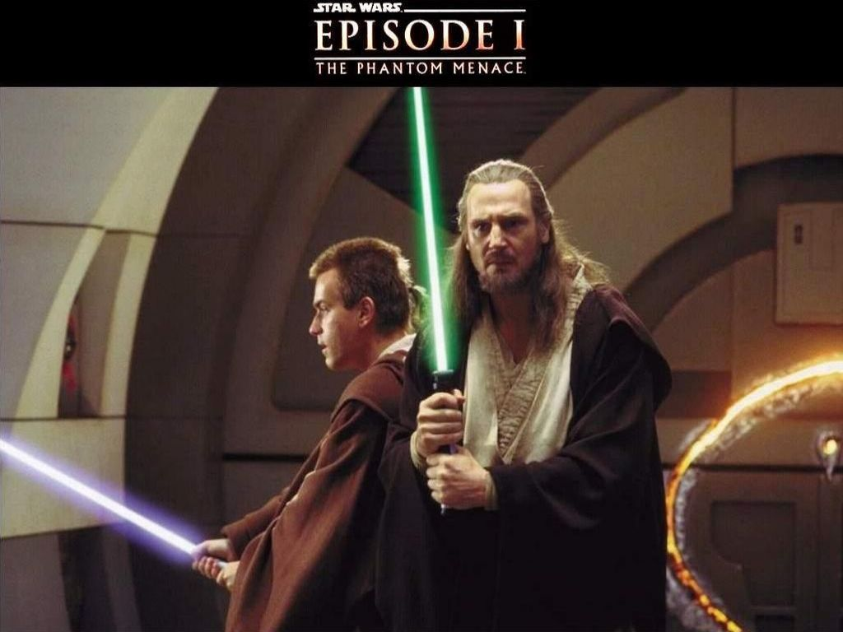
Life Has Always Revolved Around Stories—Even Today!

Slide 4
Advantages to Preaching Stories
107
God likes stories
People like stories
Stories speak to the heart
The Bible says to do it (2 Tim. 3:16-17; p. 121)
The Bible does it (p. 121)

Slide 5

Challenges to Preaching Stories
107
Issue
Didactic
Narrative
Literary type
Laws, prophecy, poetry, letters, apocalyptic
Stories, parables

Slide 6
Challenges to Preaching Stories
107
Issue
Didactic
Narrative
Interpret.
Easier
Harder
Persons
Two
Two Plus
Purpose
Stated
Implied
Length
Shorter
Longer

Slide 7
Challenges to Preaching Stories
107
Issue
Didactic
Narrative
Scripture
OT poetic & prophetic books, epistles (Romans to Revelation)
OT historical books (Genesis to Nehemiah), Gospels & Acts

Slide 8
Challenges to Preaching Stories
107
Issue
Didactic
Narrative
Audience Interest
Lower
Higher
Application Temptation
To Generalize
To
Moralize

Slide 9

How specific to focus?
108

Slide 10
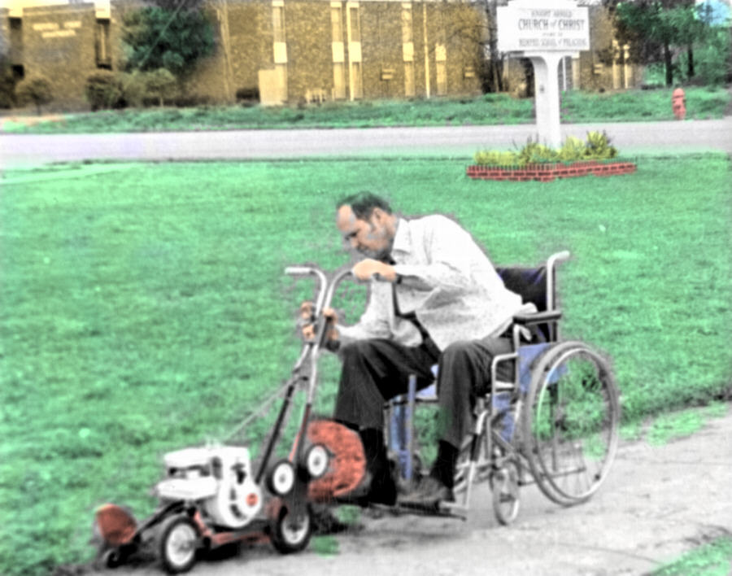
What's your excuse for bad narrative exegesis?

Slide 11

Levels of Meaning
108
Fee & Stuart, How to Read the Bible for All Its Worth, 74

Slide 12
The Joseph Narrative
OTS 56
Primeval History
Patriarchal History
Abraham 12–25:18
Isaac 25:19–26:35
Creation 1–2
Nations 10–11
Joseph 37–50
Flood 6–9
Jacob 27–36
Fall 3–5
EVENTS 1–11
PEOPLE 12–50
Human Race
Hebrew Race

Slide 13
Youthful Indiscretion
Genesis 37:1-11

Slide 14
From Palace to Prison
Genesis 37–40

Slide 15
Joseph's Exaltation
Genesis 41–50

Slide 16
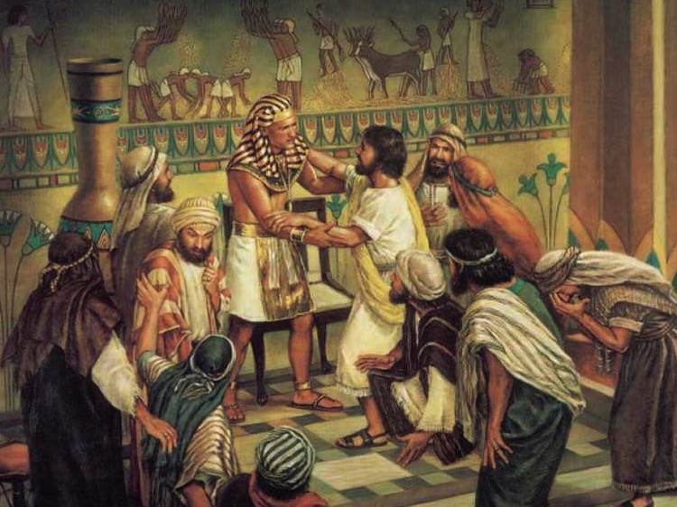
"I am Joseph!
Is my father still alive?"
(Gen. 45:3)

Slide 17
Joseph Knew God's Sovereign Purpose
You intended to harm me,
but God intended it for good to accomplish what is now being done, the saving of many lives.
Genesis 50:20 (NIV)

Slide 18
Patriarchal Family Tree
Patriarchal Family Tree
OTS 91
Terah
Haran
Nahor
Abraham
Lot
Bethuel
(of Hagar) Ishmael
(of Sarah) Isaac
Laban Rebekah
married
Jacob
Esau
Leah
Rachel
(of Leah) Reuben, Simeon, Issachar, Zebulun, Levi, Judah
(of Zilpah) Gad, Asher
(of Bilhah) Dan, Naphtali
(of Rachel)
Joseph, Benjamin
Ephraim
Manasseh
Green = line of blessing with rights of firstborn though none of these were born first (1 Chron. 5:1-2)

Slide 19
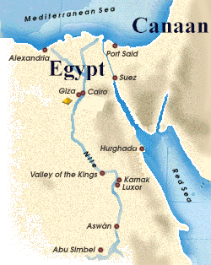
Joseph's Death
(the last verse of Genesis)
"So Joseph died at the age of a hundred and ten. And after they embalmed him, he was placed in a coffin in Egypt (50:26)
But what about God's promise of a land?

Slide 20

Key Word for Genesis:
56
Election
©2003 TBBMI
7.5.03a.
19

Slide 21
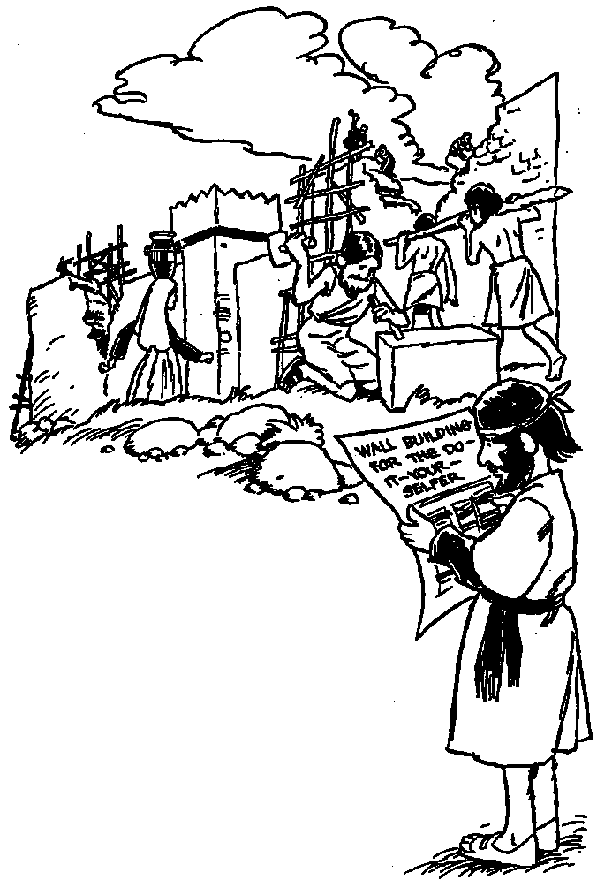
Nehemiah
Where God Guides, God Provides

Slide 22

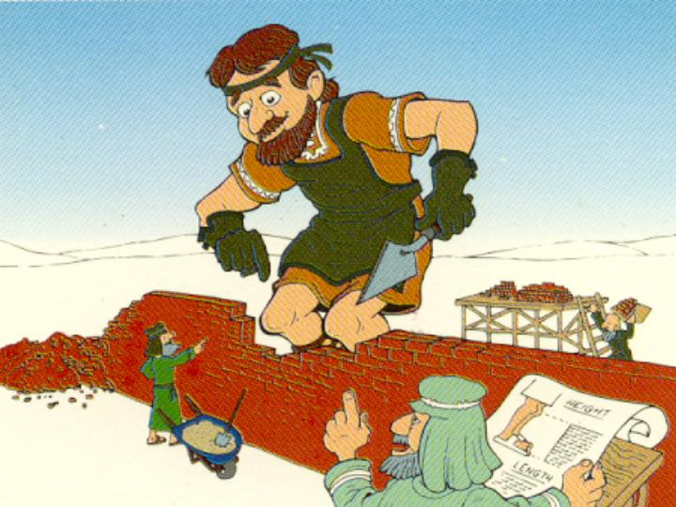
Our Key Word
Nehemiah:
Walls
Walk Through The Bible ©1989

Slide 23

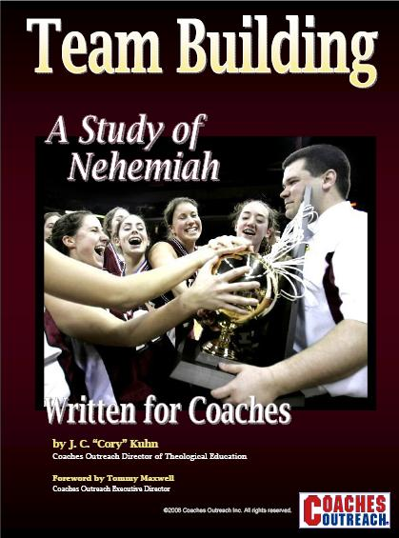

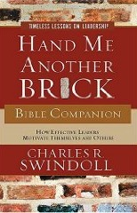
Books on Nehemiah

Slide 24
Nehemiah's Responses to Problems
305
Gene Getz, "Nehemiah," in The Bible Knowledge Commentary, 1:681
Problems
Responses
Walls broken and gates burned (1:2-3)
Grief and prayer (1:4), & motivation of the people to rebuild (2:17-18)
False accusation of the workers (2:19)
Confidence that God would give them success (2:20)
Ridicule of the workers (4:1-3)
Prayer (4:4-5) & action (greater diligence in the work, 4:6)
Plot to attack the workers (4:7-8)
Prayer & action (posting a guard, 4:9)
Physical exhaustion & threat of murder (4:10-12)
Positioning people by families with weapons (4:13, 16-18), encouraging the people (4:14, 20)
Economic crisis and greed (5:1-5)
Anger (5:6), reflection, rebuke (5:7), & action (having the people return the debtors' interest, 5:7b-11)

Slide 25
Nehemiah's Responses to Problems
305
Gene Getz, "Nehemiah," in The Bible Knowledge Commentary, 1:681
Problems
Responses
Plot to assassinate (or at least harm) Nehemiah (6:1-2)
Refusal to cooperate (6:3)
Slander against Nehemiah (6:5-7)
Denial (6:8) & prayer (6:9)
Plot to discredit Nehemiah (6:13)
Refusal to cooperate (6:11-13) & prayer (6:14)
Tobiah moved into a temple storeroom (13:4-7)
Tossing out Tobiah's furniture (13:8)
Neglect of temple tithes &
offerings (13:10)
Rebuke (13:11a), stationing the Levites at their posts (13:11b), & prayer (13:14)
Violation of the Sabbath by business activities (13:15-16)
Rebuke (13:17-18), posting of guards (13:19), & prayer (13:22)
Mixed marriages (13:23-24)
Rebuke (13:25-27), removal of a guilty priest (13:28), & prayer (13:29)

Slide 26
Nehemiah's Leadership
306
Donald K. Campbell, Nehemiah: Man in Charge, 23
While leadership is not the main purpose of the book, nevertheless, the man Nehemiah exemplifies many principles for good leadership. Some these include the following:
1. He established a reasonable & attainable goal.
2. He had a sense of mission.
3. He was willing to get involved.
4. He rearranged his priorities in order to accomplish his goal.
5. He patiently waited for God's timing.
6. He showed respect to his superior.
7. He prayed at crucial times.
8. He made his request with tact and graciousness.
9. He was well prepared and thought of his needs in advance.
10. He went through proper channels.

Slide 27
Nehemiah's Leadership
306
Donald K. Campbell, Nehemiah: Man in Charge, 23
While leadership is not the main purpose of the book, nevertheless, the man Nehemiah exemplifies many principles for good leadership. Some these include the following:
11. He took time (3 days) to rest, pray, & plan.
12. He investigated the situation firsthand.
13. He informed others only after he knew the size of the problem.
14. He identified himself as one with the people.
15. He set before them a reasonable & attainable goal.
16. He assured them God was in the project.
17. He displayed self-confidence in facing obstacles.
18. He displayed God's confidence in facing obstacles.
19. He did not argue with opponents.
20. He was not discouraged by opposition.
21. He courageously used the authority of his position.

Slide 28
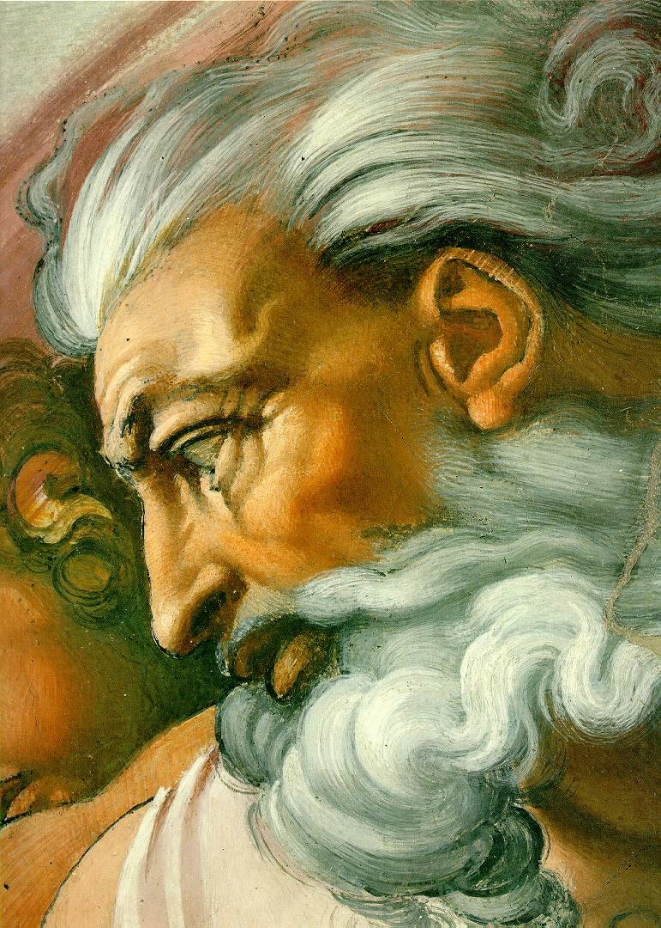
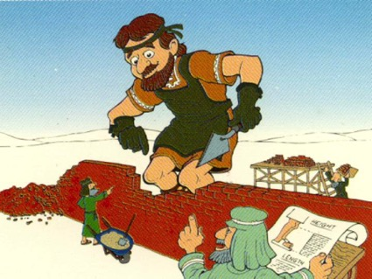
Who is the Real Hero of the Book?
Or God?
Nehemiah?

Slide 29

Sin
JUDGMENT
IDOLATRY
WRATH
D A N I E L
E Z E K I E L
PUNISHMENT
SIN
DISOBEDIENCE

Slide 30
JUDAH IS PRESERVED!
Isaiah 9:6-7
DRESSING
THE
STAGE
Summing up…
MS
N(A)
H
SG
C
ER
B
J
MN
DS
E
KB
WHY?
U
MS
Because Messiah was long prophesied to appear through the tribe of Judah
PG
RS
Handbook pg. 37-38
57
8
Notes:
Ezra slide 6

Slide 31
Z-E-N
Jer. 29:10; Ezra 3:8; Neh. 2:5-6
7
ZERUBBABEL…returns to begin rebuilding the Temple.
ZERUBBABEL
CAPTIVITY
EZRA…returns to teach the Law of the Lord.
EZRA
70 YEARS
Z-E-N
3 TREKS
100 YEARS / 50,000
Z - E - N
THREE DIPLOMATS
CAPTIVITY
NEHEMIAH
70 Years
NEHEMIAH…returns as the great Old Testament leader and rebuilder of the city's gates and its walls.
3 Treks
100 Years / 50,000
Z - E - N
Handbook pg. 37-38
66
3
Notes:
Ezra slide 16

Slide 32

How can you know if God wants you to do a certain task?

Slide 33
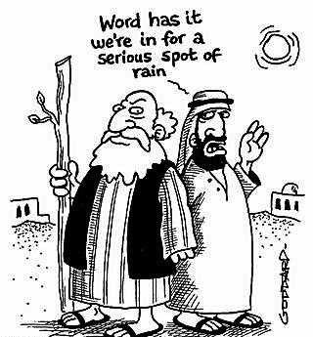
I. God gives us the information we need to do His will (1:1-3).
Word has it we're in for a serious spot of rain

Slide 34

The Persian Empire
^{Susa}
The boundaries of the empire that Cyrus II initiated
and Darius I consolidated stretched from Greece to India

Slide 35


The Postexilic Era
560
The Postexilic Era
Temple work
Prophets:
Haggai
Zechariah
Malachi
605
586
539
536
520
516
483-473
444-425
Others:
Zerubbabel
Esther
Ezra
Nehemiah
Persian Kings:
Cyrus
Darius
Xerxes
Artaxerxes
Notes:
Ezra slide 5

Slide 36

II. God gives us the vision we need to do His will (1:4-11a).

Slide 37
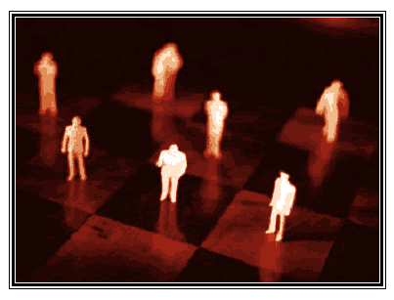
III. God gives us the position we need to do His will (1:11b).

Slide 38

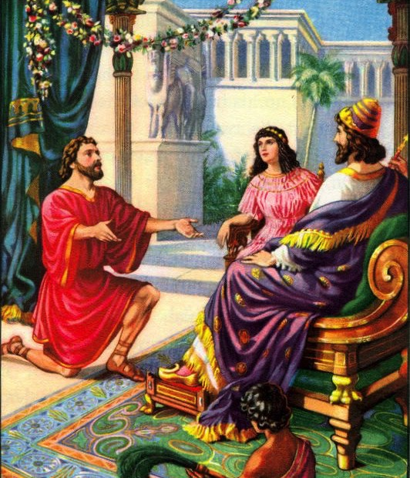
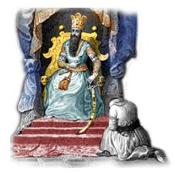
The Cupbearer
Notes:
In those days I was the king's cup-bearer (11b).
1. Wiersbe also notes, "A cupbearer was much more than our modern 'butler' (see Gen. 40). It was a position of great responsibility and privilege. At each meal, he tested the king's wine to make sure it wasn't poisoned. A man who stood that close to the king in public had to be handsome, cultured, knowledgeable in court procedures, and able to converse with the king and advise him if asked (see 41:1–13). Because he had access to the king, the cupbearer was a man of great influence, which he could use for good or for evil."
2. "That Nehemiah, a Jew, held such an important position in the palace speaks well of his character and ability (Dan. 1:1–4). For nearly a century, the Jewish remnant had been back in their own land, and Nehemiah could have joined them; but he chose to remain in the palace. It turned out that God had a work for him to do there that he could not have accomplished elsewhere. God put Nehemiah in Susa just as He had put Esther there a generation before, and just as He had put Joseph in Egypt and Daniel in Babylon. When God wants to accomplish a work, He always prepares His workers and puts them in the right places at the right time."
Ibid.

Slide 39
How can you know if God wants you to do a certain task?

Slide 40



Key Idea of Nehemiah 1
God gives you the
information, vision, & position
KNOW THE FACTS
vision
you need to do His will.

Slide 41
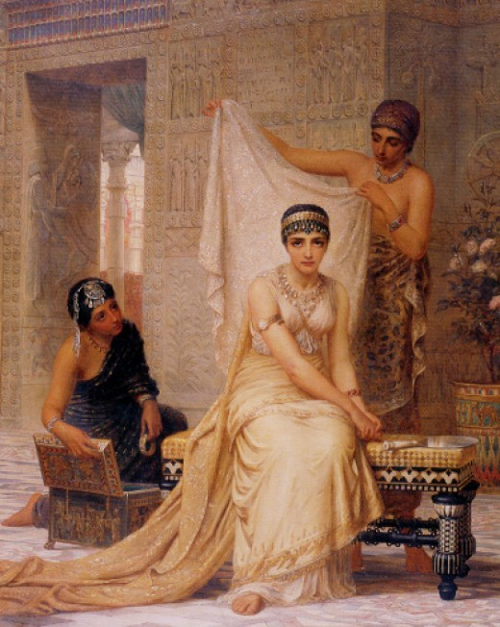
OT Narrative is Unique
109
Not just stories
Not allegories
Do not always teach directly
Each part does not have a moral
Fee & Stuart, 75-77

Slide 42

My View of the Bible's Theme
OTS 33
The Bible narrates
God's restoring man to participate in His kingdom rule for His own glory
mandated in Eden but lost in the Fall
and accomplished by redeeming man
through Israel as a kingdom of priests
and ultimately through the Messiah,
who will reign as Saviour and King
to fulfill the Abrahamic Covenant
Notes:
Rev 20-22 PPT for this slide and the next five slides

Slide 43
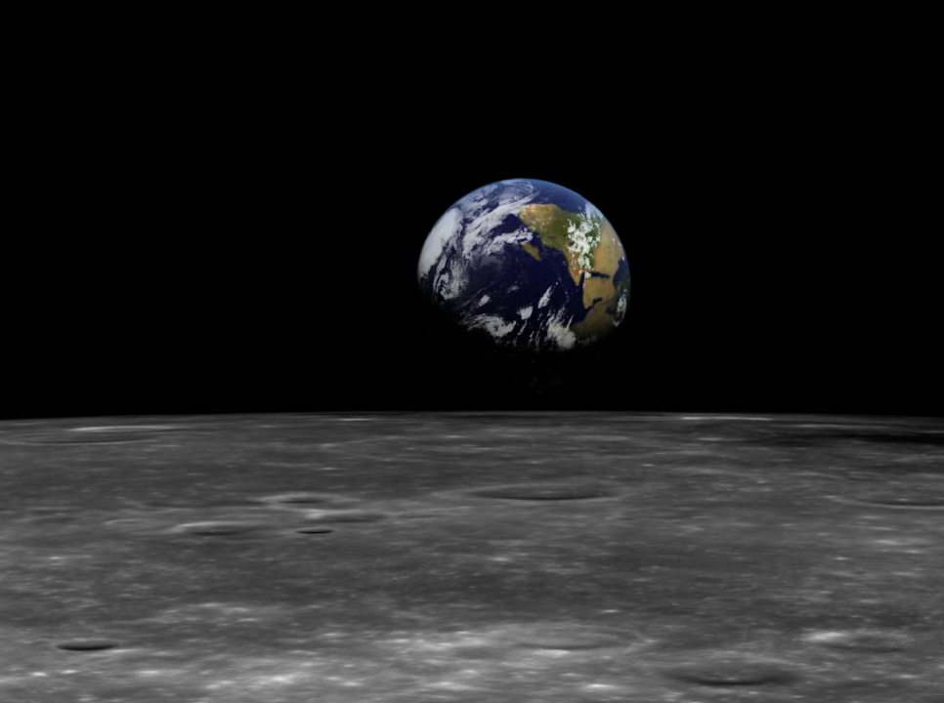
The Kingdom in Genesis 1
NTS
444
• Uncreated God (1:1)
• Creation by Word alone (1:4)
• Creation with ease
• Sun and moon [gods] created (1:16)
• Shared rule with man (1:26)

Slide 44
The Kingdom of God:
The Bible's All-Encompassing Theme
NTS
445
Genesis 1:26-28
"Then God said, 'Let us make man in our image, in our likeness, and let them rule over the fish … birds … livestock … all the earth, and over all the creatures that move along the ground…' God blessed them and said to them, 'Be fruitful and increase in number; fill the earth and subdue it. Rule over the fish of the sea and the birds of the air and over every living creature that moves on the ground.'"
Revelation 22:5
"There will be no more night. They will not need the light of a lamp or the light of the sun, for the Lord God will give them light. And they will reign for ever and ever."
The Bible's Theme: God extends His rule to man
Command
Covenants
Fulfillment

Slide 45
Kingdom & Covenants Timeline
22 &
337
9g
Dr. Rick Griffith • Singapore Bible College • BibleStudyDownloads.org
Kingdom Teaching...
Adam rules with God (Gen. 1:26, 28; 2:19)
Satan begins rule as god of this world (Gen. 3:15;
2 Cor. 4:4)
God covenants with Abraham to reestablish man's rule via Israel as a "kingdom of priests" (Gen. 12:1-3; Exod. 19:6)
Israel's failure to witness to nations as a kingdom of priests is judged via exile under foreign rule
Israel rejects Messiah's offer of kingdom (Matt. 12:41-42; 23:37-39)
Jesus extends His kingdom in mystery form to the Church (Matt. 13)
Christ subdues Israel's enemies and nation believes (Rom. 11:26-27)
Christ rules over everything with saints (Eph. 1:9-10; Rev. 20:1-6; 22:5b)
Fall of Man (Gen. 3)
Noahic Covenant
Genesis 6:18; 9:8-17
Land Covenant
ISRAEL
CHURCH
MESSIANIC KINGDOM
(National Focus)
The "New Man" (Eph. 2:15)
Millennial Eternal
land
Genesis 15:18 (cf. Deut. 30:1-10) promises:
Land from Wadi of Egypt to Euphrates River (Isa. 27:12)
Eternal possession of land (Gen. 17:8) after exile/restoration
Whole world blessed via the land (Isa. 14:1-2)
Israel judged for rejecting Messiah by dispersion away from land for 19 centuries
(AD 70–AD 1948) but now partially restored (Ezek. 37:1-7)
Full restoration (Ezek. 37:8-28) Jerusalem world capital
(Isa. 2:1-5)
New Jerusalem
(Rev. 21–22)
Davidic Covenant
Christ is Head over His Church, which is a spiritual temple (Eph. 2:19-22; 2 Cor. 6:16)
Christ reigns over the world
(Isa. 11)
with saints (Rev. 5:10; 20:4-6)
Christ hands kingdom over to Father (1
Cor. 15:24)
Genesis 12:1-3
2 Samuel 7:12-16 promises:
Sons ("house" never wiped out)
Kingdom (political dynasty)
Throne (right to rule by descendants)
Temple (son to build it)
seed
Abrahamic Covenant
New Covenant
All
things made new!
(Rev. 21:5)
All 5 elements fulfilled in national restoration (Zech. 8)
Jeremiah 31:31-34 promises:
Forgiveness
Indwelling Spirit
New heart, nature, mind
Reunification of Israel and Judah
No need for evangelism
Mosaic Law replaced with first three elements of the New Covenant (Luke 22:20; 2 Cor. 3:6)
blessing
Mosaic Covenant
Ninth Edition
29 March 2018
Law abolished, fulfilled, and replaced at the cross (Rom. 7:1-6;1 Cor. 9:19-21; Heb. 8:13)
Temporary (Gal. 3:19) and conditional (Deut. 28) to reveal sin (Rom. 7:7) and regulate Israel (Gal. 3:23-25)
Scripture has a dual kingdom-covenant theme. Israel's role from Abraham to Christ expands to include the Church (continuity) yet the Church never replaces the nation as the "new Israel" (discontinuity).
Israel will again enjoy world prominence after trusting Christ at His second coming.
Notes:
Slides 13 and 127 repeated

Slide 46
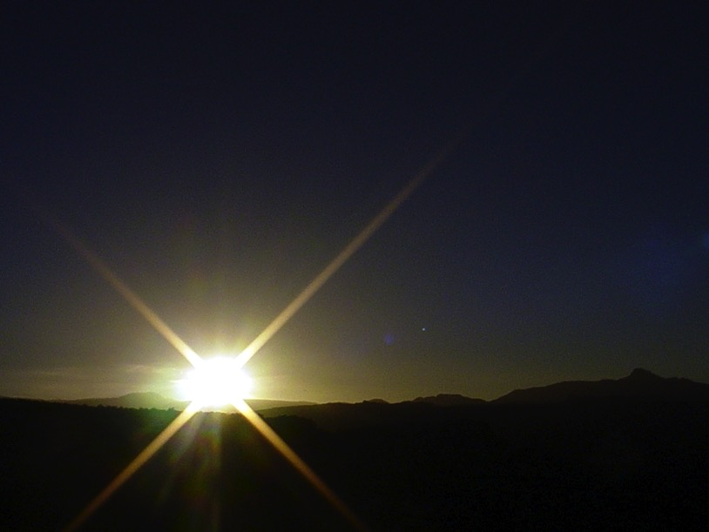


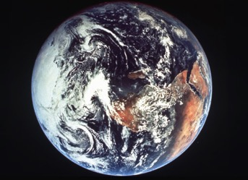
The Bible's Chiasm
NTS
446
Repeated Patterns in Reverse Order
Christ's Redemption
Christ's Rule
Man's Rule Lost at
Fall
Man's
Rule Restored at Millennium
Creation
New Creation
Notes:
Creation in Genesis 1–2 is repeated In the Restored, New Creation in Rev 21–22
Man was created to rule over the fish, birds, and land animals (Gen. 1:28) but he gave over his rule over to the god of this world, Satan (2 Cor. 4:4)
However, this rule is restored during the 1000-year reign of the saints (Rev. 20:4-6)
But Christ is the central Person of history: both as Lamb (Redeemer) and as Lion (Ruler of all creation in the line of David)

Slide 47
The New Heaven & New Earth
NTS
447

Slide 48
The Preparing Expository Sermons Process
III. Methodology: How to Preach Narratives
27-28, 251
Based on Ramesh Richard's text, Preparing Expository Sermons
TEXT
SERMON
5 Desired Listener Response
Brain
4 The Three
Developmental
Questions
Purpose Bridge
3.2 Exegetical Idea
CPT
Heart
CPS
6 Homiletical Idea
7 Homiletical
Outline
8 Clarity
9 Intro/Concl
3.1 Exegetical
Outline
Structure
Skeleton
Structure
2 Analyze Text
Study
Flesh
Preach
10 MSS &
Preach
1 Choose Text
White text shows 10 steps adapted from Haddon Robinson, Biblical Preaching (notes, 105)
Notes:
PPT presentation 29

Slide 49
BLOCKING DIAGRAM
113
Front of Stage or Platform
Colder
Warmer
AREA 4 | AREA 1 | AREA 3
AREA 6 | AREA 2 | AREA 5
Strongest area
Weakest area
Grant & Reed, Telling Stories to Touch the Heart, 68

Slide 50
BLOCKING DIAGRAM
113
Front of Stage or Platform
AREA 4 Cool Distress, Conflict (David arguing) | AREA 1 Medium Confrontational (David's fight with Goliath) | AREA 3 Warm Intimate (David prays, picks stones)
AREA 6 Cold Extreme Alienation (Goliath dies) | AREA 2 Medium Distant, Aloof (David arrives at camp) | AREA 5 Warm More "Distant" (David's scene with Jesse)
3
4
5
2
1
Grant & Reed, Telling Stories to Touch the Heart, 69-70

Slide 51
Black

Slide 52


Preaching (Homiletics) link at BibleStudyDownloads.org
Get this presentation for free!
Notes:
Preaching (pr)
Homiletics

